Slide 1

Lecture 7
Configuring and Troubleshooting DNS

Slide 2
Module Overview
Installing the DNS Server Role
Configuring the DNS Server Role
Configuring DNS Zones
Configuring DNS Zone Transfers
Managing and Troubleshooting DNS

Slide 3
1: Installing the DNS Server Role
Overview of the Domain Name System Role
Overview of the DNS Namespace
DNS Improvements for Windows Server 2012
DNS Improvements for Windows Server 2012 R2

Slide 4
Overview of the Domain Name System Role
Domain Name System is a hierarchical distributed database
DNS is the foundation of the Internet naming scheme
DNS supports accessing resources by using alphanumeric names
InterNIC is responsible for managing the domain namespace
DNS was created to support the Internet’s growing number of hosts

Slide 5




















Overview of the DNS Namespace
Root Domain
Top-Level Domain
net
com
org
Second-Level Domain
contoso
Subdomain
west
south
east
FQDN:
SERVER1.sales.south.contoso.com
sales
Host: SERVER1

Slide 6
DNS Improvements for Windows Server 2012
New or enhanced features in the Windows Server 2012 version of DNS include:
Background zone loading
IP version 6 support
Support for read-only domain controllers
Global single names
Global query block list

Slide 7
DNS Improvements for Windows Server 2012 R2
New or enhanced features in the Windows Server 2012 R2 version of DNS include:
DNS Security Extensions
DNS Devolution
DNS Cache Locking
DNS Socket Pool
Name Resolution Policy Table

Slide 8




















Considerations for Deploying the DNS Server Role
DNS Server
Subnet 2
DNS
Zone
DNS Client
Subnet 1
DNS Client
DNS Server
Subnet 3
DNS
Zone
DNS Client

Slide 9
2: Configuring the DNS Server Role
What Are the Components of a DNS Solution?
DNS Resource Records
What Are Root Hints?
What Are DNS Queries?
What Is Forwarding?
How DNS Server Caching Works

Slide 10








What Are the Components of a DNS Solution?
Root “.”
Resource Record
.com
.edu
Resource Record
DNS Resolvers
DNS Servers
DNS Servers on the Internet

Slide 11
DNS Resource Records
DNS resource records include:
SOA: Start of Authority
A: Host Record
CNAME: Alias Record
MX: Mail Exchange Record
SRV: Service Resources
NS: Name Servers
AAAA: IPv6 DNS Record

Slide 12





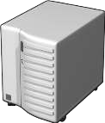



What Are Root Hints?
Root hints contain the IP addresses for DNS root servers
Root (.) Servers
DNS Servers
Root Hints
com
DNS Server
Client
microsoft

Slide 13









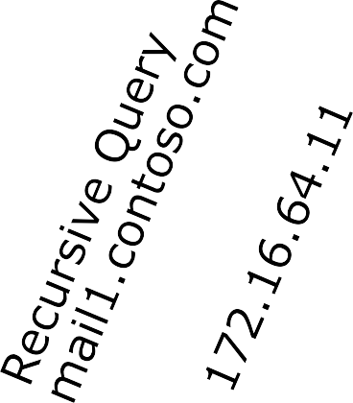



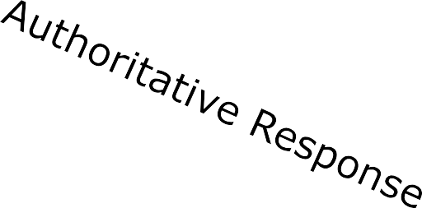
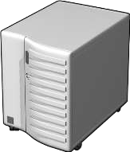











What Are DNS Queries?
An iterative query directed to a DNS server may be answered with a referral to another DNS server
_{Local DNS Server} Iterative Query ^{Root Hint (.)}
Ask .com
A recursive query is sent to a DNS server and requires a complete answer _{.com}
mail1.contoso.com
Contoso.com Database
172.16.64.11
DNS Clien ^{Client Server} Local DNS Server
A query is a request for name resolution and is directed to a
DNS server
Queries are recursive or iterative
DNS clients and DNS servers initiate queries
DNS servers are authoritative or nonauthoritative for
a namespace
An authoritative DNS server for the namespace will either:
  Return the requested IP address
  Return an authoritative “No”
A nonauthoritative DNS server for the namespace will either:
  Check its cache
  Use forwarders
  Use root hints
t

Slide 14





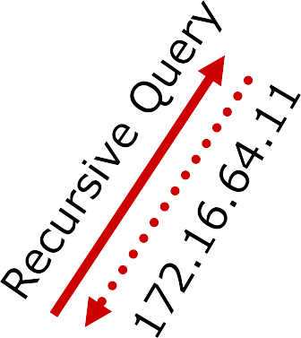








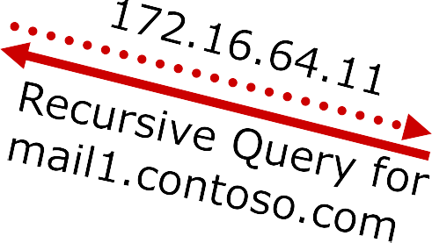
What Is Forwarding?
A forwarder is a DNS server designated to resolve external or offsite DNS domain names
Conditional forwarding forwards requests using a domain name condition
All other DNS domains
Local DNS _{ISP DNS}
Client Computer
Contoso.com DNS
Iterative Query
Ask .com
Forwarder
Root Hint (.)
.com
contoso.com
Local DNS Server
Client Server

Slide 15









How DNS Server Caching Works
DNS server cache
Host name | IP address | TTL
ServerA.contoso.com | 192.168.8.44 | 28 seconds
Server A at
192.168.8.44
ServerA
Client1
Server A at
192.168.8.44
Client2

Slide 16
3: Configuring DNS Zones
What Is a DNS Zone?
What Are the DNS Zone Types?
What Are Forward and Reverse Lookup Zones?
What are Stub Zones?
DNS Zone Delegation

Slide 17















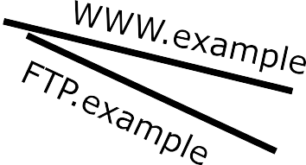
What Is a DNS Zone?
Internet
“.”
DNS root domain
.com
microsoft.com domain
microsoft.com
www.microsoft.com
ftp.microsoft.com
example.microsoft.com
microsoft.com zone
Zone database
example.microsoft.com
zone
example.microsoft.com www.example.microsoft.com
Zone database
ftp.example.microsoft.com

Slide 18
What Are the DNS Zone Types?
Zones | Description
Primary | Read/write copy of a DNS database
Secondary | Read-only copy of a DNS database
Stub | Copy of a zone that contains only records used to locate name servers
Active Directory integrated | Zone data is stored in Active Directory rather than in zone files

Slide 19
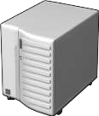








What Are Forward and Reverse Lookup Zones?
Namespace: training.contoso.com
Forward zone | Training | DNS Client1 | 192.168.2.45
 |  | DNS Client2 | 192.168.2.46
 |  | DNS Client3 | 192.168.2.47
Reverse zone | 1.168.192.in- addr.arpa | 192.168.2.45 | DNS Client1
 |  | 192.168.2.46 | DNS Client2
 |  | 192.168.2.47 | DNS Client3
DNS Server Authorized for training
DNS Client2 = ?
192.168.2.46 = ?
DNS Client3
DNS Client1
DNS Client2

Slide 20







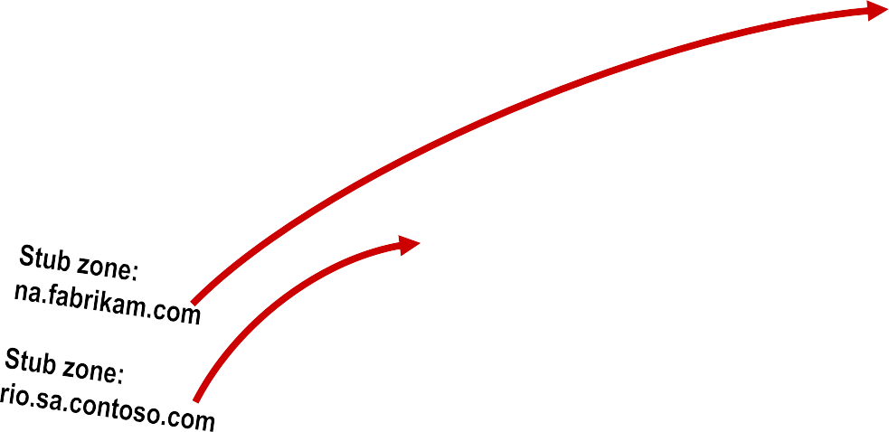

What Are Stub Zones?
Without stub zones, the ny.na.contoso.com server must query several servers to find the server that hosts the na.fabrikam.com zone
DNS server
DNS server
Contoso.com (Root domain)
With a stub zone defined, the location of the na.fabrikam.com zone is known without querying multiple DNS servers
DNS server
DNS server
Contoso.com (Root domain)
_{DNS server DNS server} fabrikam.com
DNS server
na.contoso.com sa.contoso.com
_{DNS server DNS server} na.fabrikam.com
ny.na.contoso.com rio.sa.contoso.com
DNS server
DNS server
fabrikam.com
DNS server
na.contoso.com
sa.contoso.com
DNS server
na.fabrikam.com
DNS server
ny.na.contoso.com
rio.sa.contoso.com

Slide 21



DNS Zone Delegation
contoso.com
Training.contoso.com
Sales.contoso.com

Slide 22
4: Configuring DNS Zone Transfers
What Is a DNS Zone Transfer?
Configuring Zone Transfer Security

Slide 23


















What Is a DNS Zone Transfer?
A DNS zone transfer is the synchronization of authoritative DNS zone data between DNS servers
1
SOA query for a zone
2
SOA query answered
3
IXFR or AXFR query for a zone
4
IXFR or AXFR query answered (zone transferred)
Secondary server
Primary and
Master server

Slide 24



Configuring Zone Transfer Security
Restrict zone transfer to specified servers
Encrypt zone transfer traffic
Consider using Active Directory-integrated zones
Primary Zone
Secondary Zone

Slide 25
5: Managing and Troubleshooting DNS
What Is Time to Live, Aging, and Scavenging?
Demonstration: How to Manage DNS Records
Tools That Identify Problems With DNS
Demonstration: How to Test the DNS Server Configuration
Monitoring DNS Using the DNS Event Log
Monitoring DNS Using Debug Logging

Slide 26
What Is Time to Live, Aging, and Scavenging?
Feature | Description
Time to Live (TTL) | Indicates how long a DNS record will remain valid
Aging | Occurs when records that have been inserted into the DNS server reach their expiration and are removed
Scavenging | Performs DNS server resource record grooming for old records in DNS

Slide 27
Tools That Identify Problems With DNS
Tool | Used to:
Nslookup | Troubleshoot DNS problems
Dnscmd | Edit the DNS configuration
Dnslint | Diagnose common DNS issues
Ipconfig | Display and clear DNS resolver cache
Monitoring tab | Perform queries against server

Slide 28
Monitoring DNS Using the DNS Event Log
Monitor DNS events in the event log to:
  Monitor zone transfer information
  Monitor computer events

Slide 29
Monitoring DNS Using Debug Logging
Enable DNS debug logging to view granular verbose information about DNS activities

